Slide 1

CSE423 Virtualization and Cloud Computing
Faculty Name:
Dr. Madhavi Dhingra
Assistant Professor
Sitting Room-> 34-202

Slide 2
What is Virtualization?
Virtualization is technology that you can use to create virtual representations of servers, storage, networks, and other physical machines.
Virtual software mimics the functions of physical hardware to run multiple virtual machines simultaneously on a single physical machine.
Businesses use virtualization to use their hardware resources efficiently and get greater returns from their investment. It also powers cloud computing services that help organizations manage infrastructure more efficiently.

Slide 3
Why is virtualization important?
By using virtualization, you can interact with any hardware resource with greater flexibility.
Physical servers consume electricity, take up storage space, and need maintenance. You are often limited by physical proximity and network design if you want to access them.
Virtualization removes all these limitations by abstracting physical hardware functionality into software. You can manage, maintain, and use your hardware infrastructure like an application on the web.

Slide 4
Virtualization example
Consider a company that needs servers for three functions:
Store business email securely
Run a customer-facing application
Run internal business applications
Each of these functions has different configuration requirements:
The email application requires more storage capacity and a Windows operating system.
The customer-facing application requires a Linux operating system and high processing power to handle large volumes of website traffic.
The internal business application requires iOS and more internal memory (RAM).

Slide 5
What company does?
To meet these requirements, the company sets up three different dedicated physical servers for each application. The company must make a high initial investment and perform ongoing maintenance and upgrades for one machine at a time. The company also cannot optimize its computing capacity. It pays 100% of the servers’ maintenance costs but uses only a fraction of their storage and processing capacities.
Efficient hardware use
With virtualization, the company creates three digital servers, or virtual machines, on a single physical server. It specifies the operating system requirements for the virtual machines and can use them like the physical servers. However, the company now has less hardware and fewer related expenses.
Infrastructure as a service
The company can go one step further and use a cloud instance or virtual machine from a cloud computing provider such as AWS. AWS manages all the underlying hardware, and the company can request server resources with varying configurations. All the applications run on these virtual servers without the users noticing any difference. Server management also becomes easier for the company’s IT team.

Slide 6
What are the benefits of virtualization?
Virtualization provides several benefits to any organization:
Efficient resource use
Virtualization improves hardware resources used in your data center. For example, instead of running one server on one computer system, you can create a virtual server pool on the same computer system by using and returning servers to the pool as required. Having fewer underlying physical servers frees up space in your data center and saves money on electricity, generators, and cooling appliances.
Automated IT management
Now that physical computers are virtual, you can manage them by using software tools. Administrators create deployment and configuration programs to define virtual machine templates. You can duplicate your infrastructure repeatedly and consistently and avoid error-prone manual configurations.
Faster disaster recovery
When events such as natural disasters or cyberattacks negatively affect business operations, regaining access to IT infrastructure and replacing or fixing a physical server can take hours or even days. By contrast, the process takes minutes with virtualized environments. This prompt response significantly improves resiliency and facilitates business continuity so that operations can continue as scheduled.

Slide 7
How does virtualization work?
Virtualization uses specialized software, called a hypervisor, to create several cloud instances or virtual machines on one physical computer.
Cloud instances or virtual machines
After you install virtualization software on your computer, you can create one or more virtual machines. You can access the virtual machines in the same way that you access other applications on your computer. Your computer is called the host, and the virtual machine is called the guest. Several guests can run on the host. Each guest has its own operating system, which can be the same or different from the host operating system.
From the user’s perspective, the virtual machine operates like a typical server. It has settings, configurations, and installed applications. Computing resources, such as central processing units (CPUs), Random Access Memory (RAM), and storage appear the same as on a physical server. You can also configure and update the guest operating systems and their applications as necessary without affecting the host operating system.
Hypervisors
The hypervisor is the virtualization software that you install on your physical machine. It is a software layer that acts as an intermediary between the virtual machines and the underlying hardware or host operating system. The hypervisor coordinates access to the physical environment so that several virtual machines have access to their own share of physical resources.
For example, if the virtual machine requires computing resources, such as computer processing power, the request first goes to the hypervisor. The hypervisor then passes the request to the underlying hardware, which performs the task.

Slide 8
How is virtualization different from cloud computing?
Cloud computing is the on-demand delivery of computing resources over the internet with pay-as-you-go pricing. Instead of buying, owning, and maintaining a physical data center, you can access technology services, such as computing power, storage, and databases, as you need them from a cloud provider.
Virtualization technology makes cloud computing possible. Cloud providers set up and maintain their own data centers. They create different virtual environments that use the underlying hardware resources. You can then program your system to access these cloud resources by using APIs. Your infrastructure needs can be met as a fully managed service.

Slide 9
Virtualization in Cloud Computing
Virtualization is the "creation of a virtual (rather than actual) version of something, such as a server, a desktop, a storage device, an operating system or network resources".
In other words, Virtualization is a technique, which allows to share a single physical instance of a resource or an application among multiple customers and organizations. It does by assigning a logical name to a physical storage and providing a pointer to that physical resource when demanded.
What is the concept behind the Virtualization?
Creation of a virtual machine over existing operating system and hardware is known as Hardware Virtualization. A Virtual machine provides an environment that is logically separated from the underlying hardware.
The machine on which the virtual machine is going to create is known as Host Machine and that virtual machine is referred as a Guest Machine

Slide 10
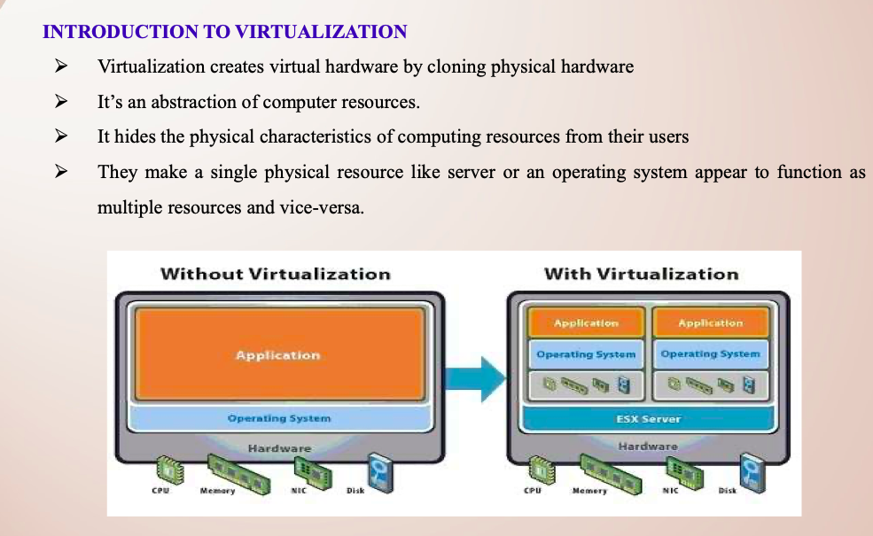

Slide 11
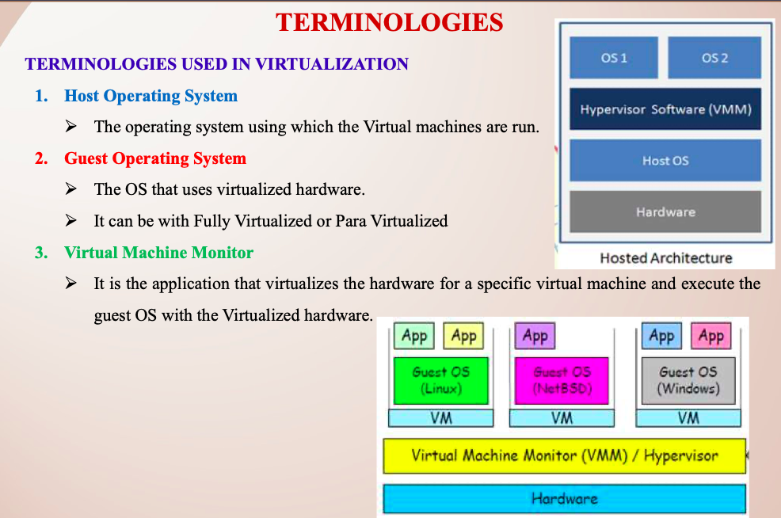

Slide 12
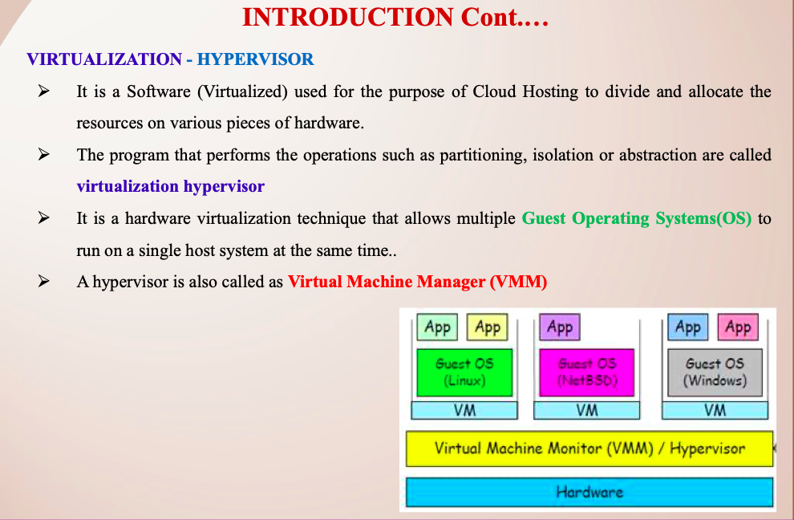

Slide 13
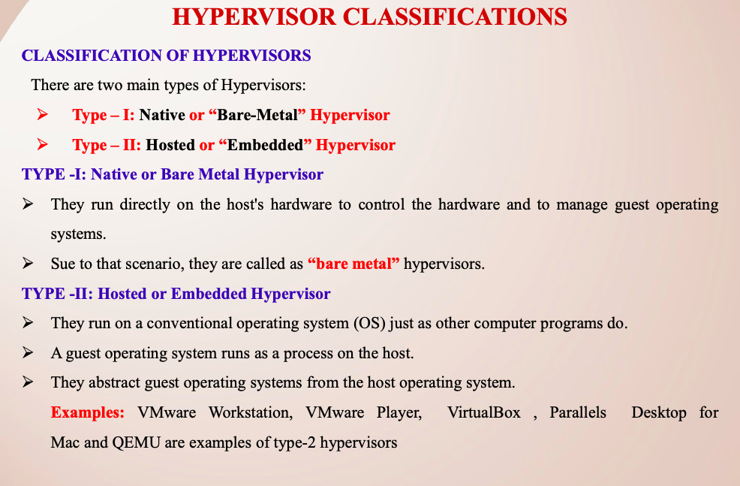

Slide 14
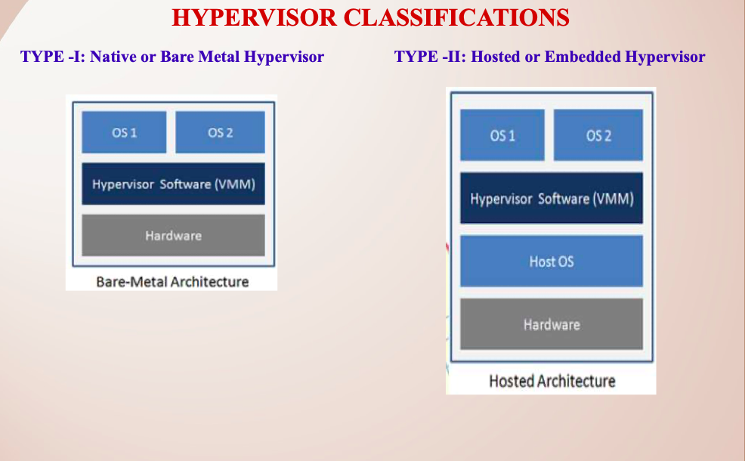

Slide 15
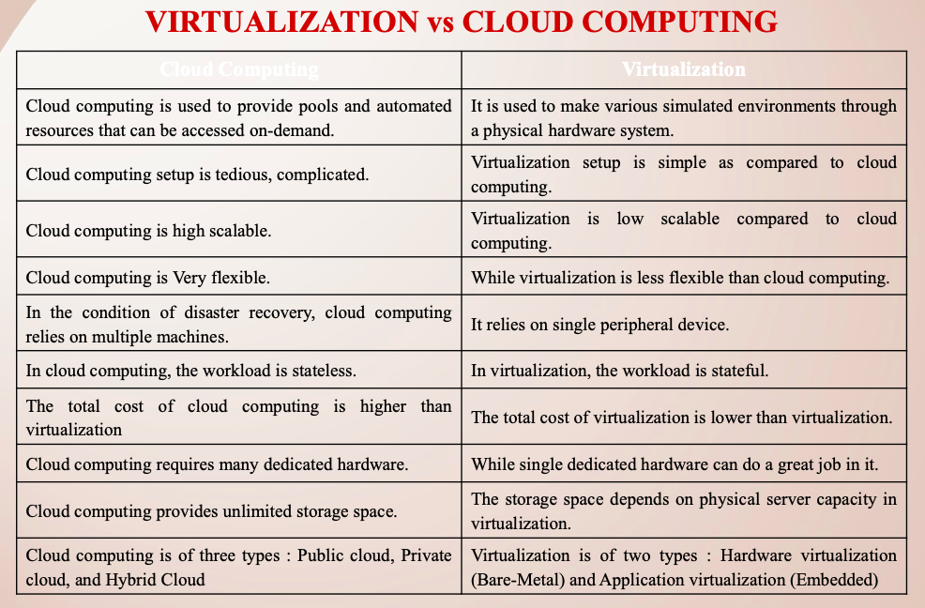

Slide 16
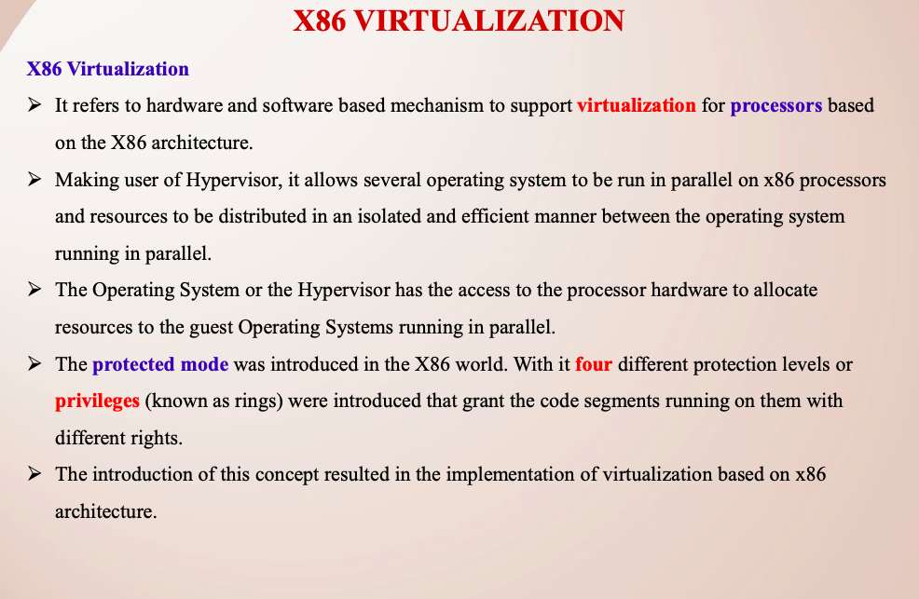

Slide 17
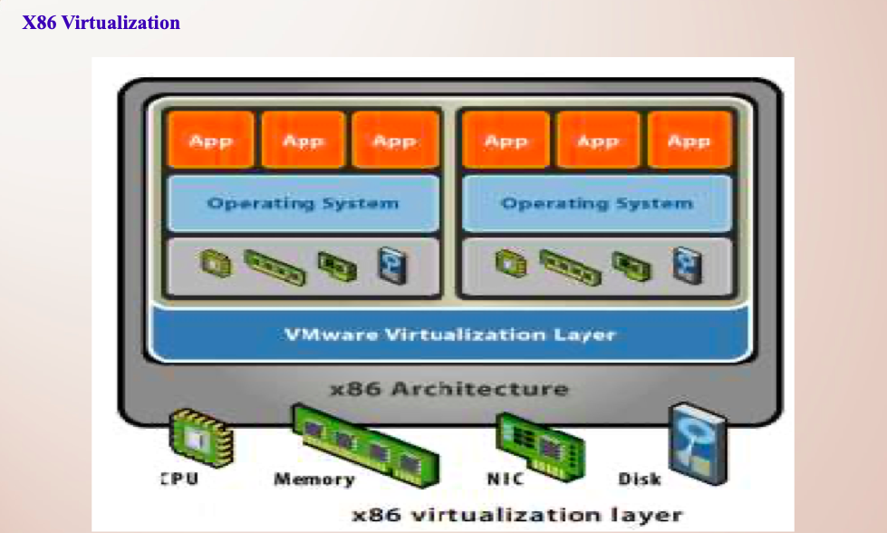

Slide 18
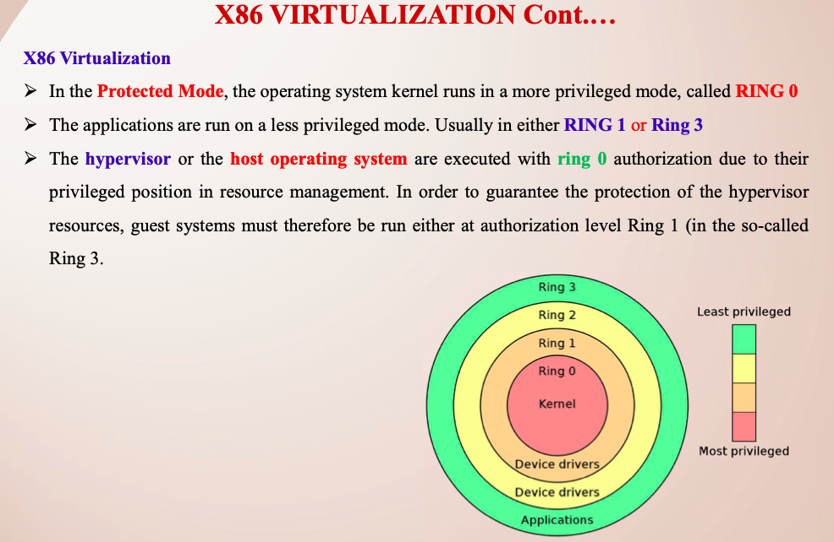

Slide 19
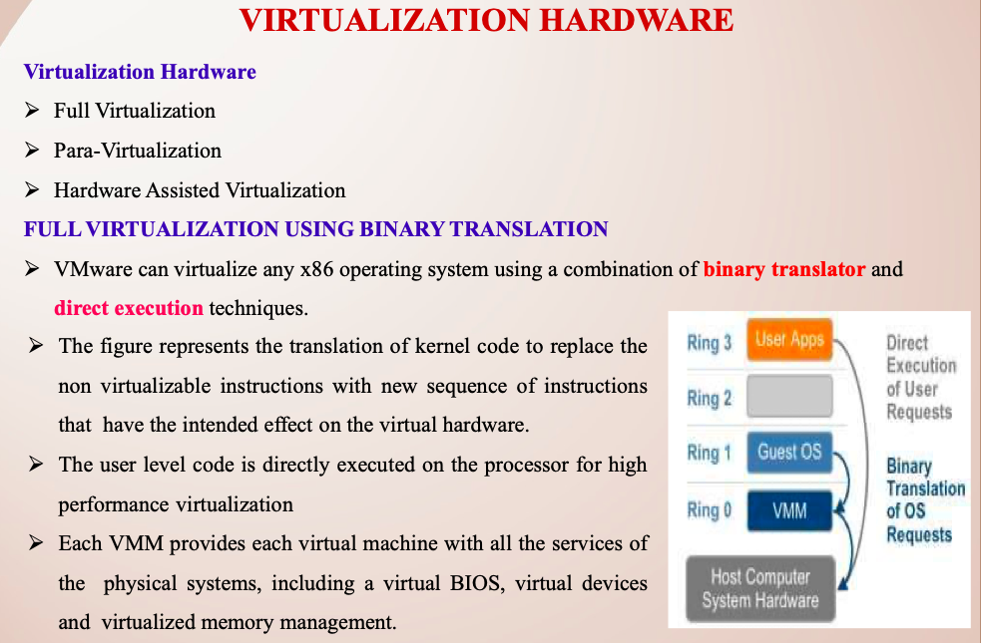

Slide 20
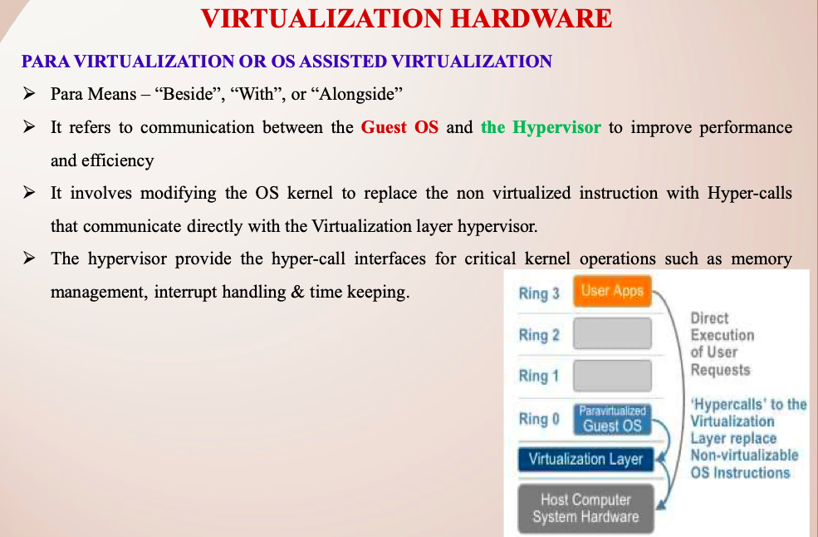

Slide 21
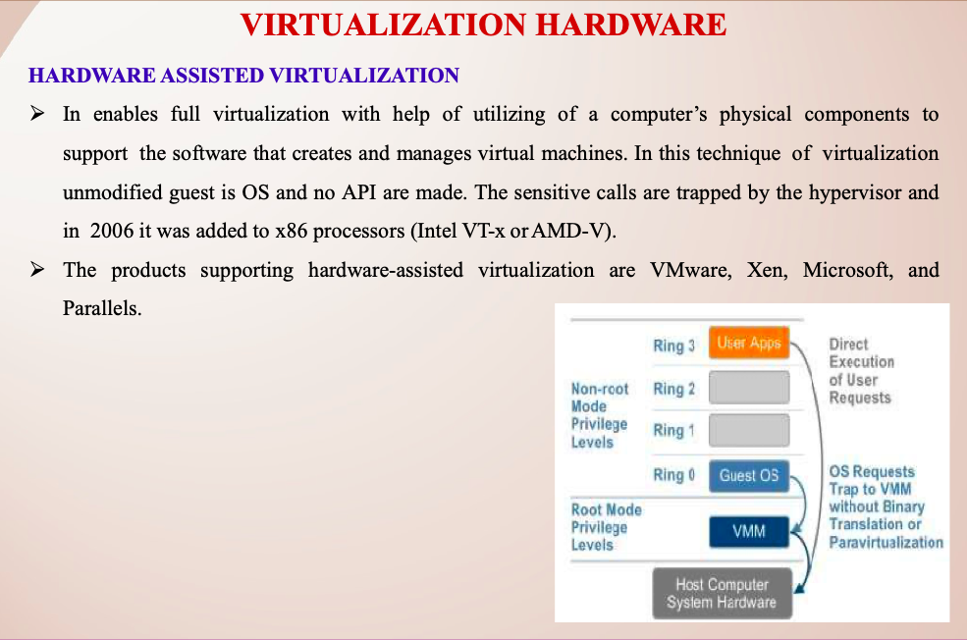

Slide 22
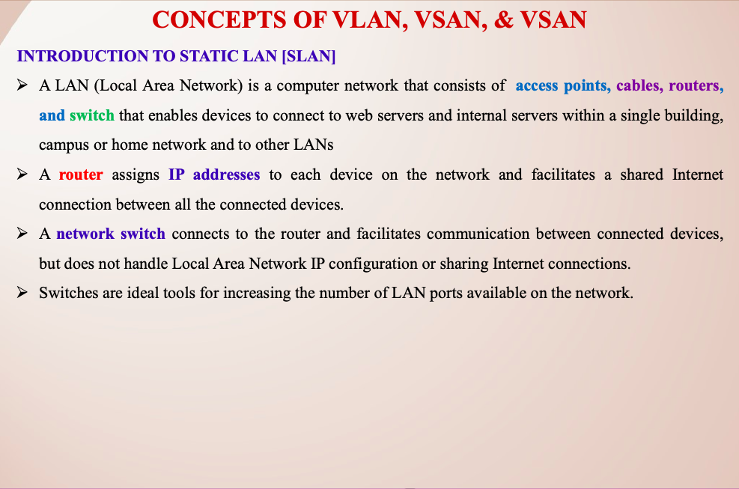

Slide 23
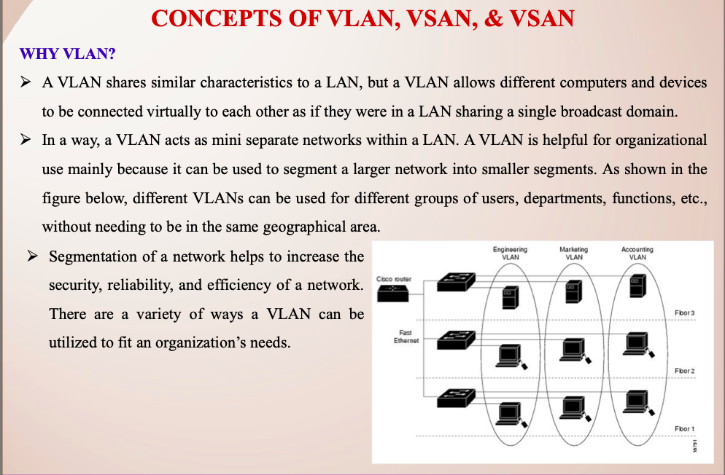

Slide 24
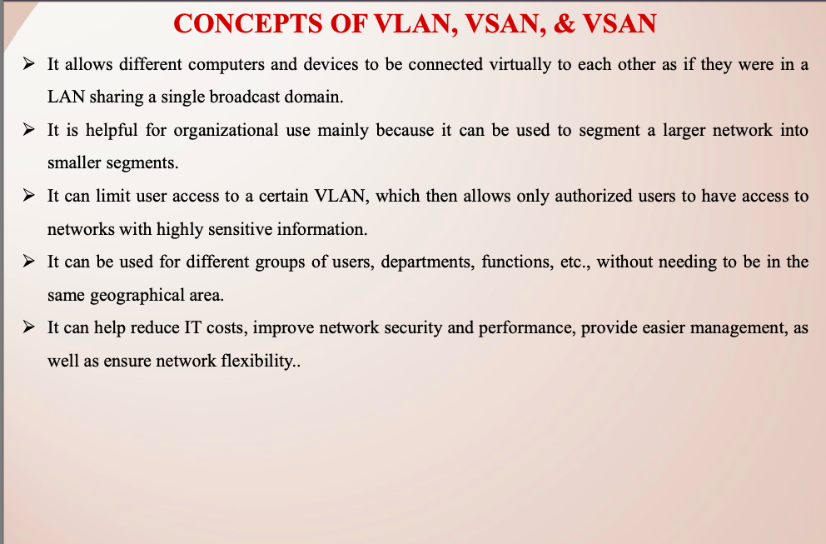

Slide 25
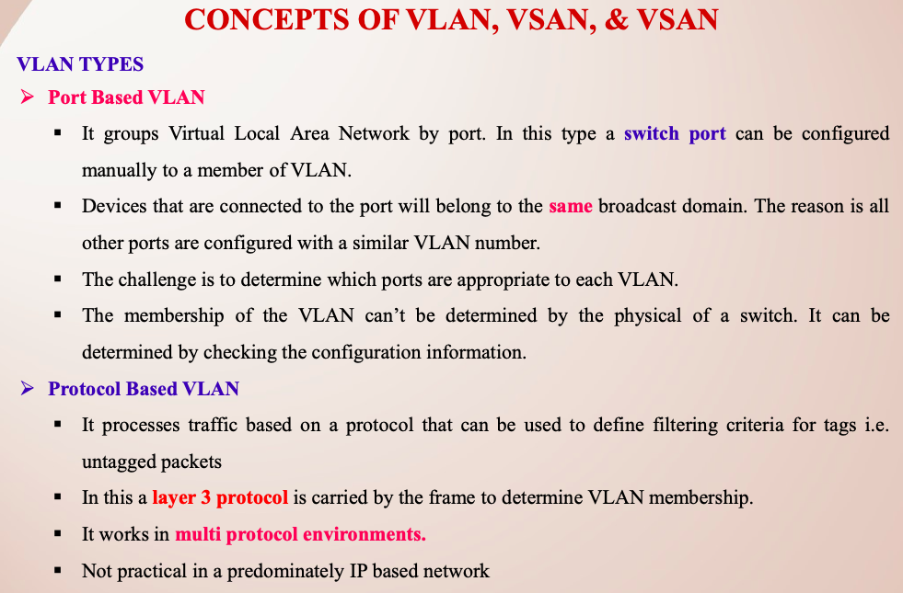

Slide 26
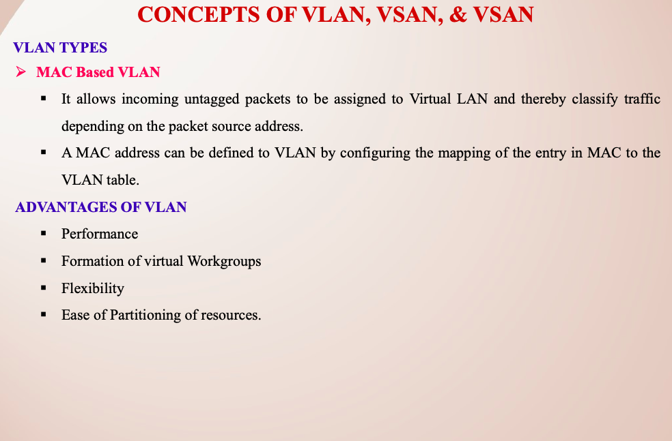

Slide 27
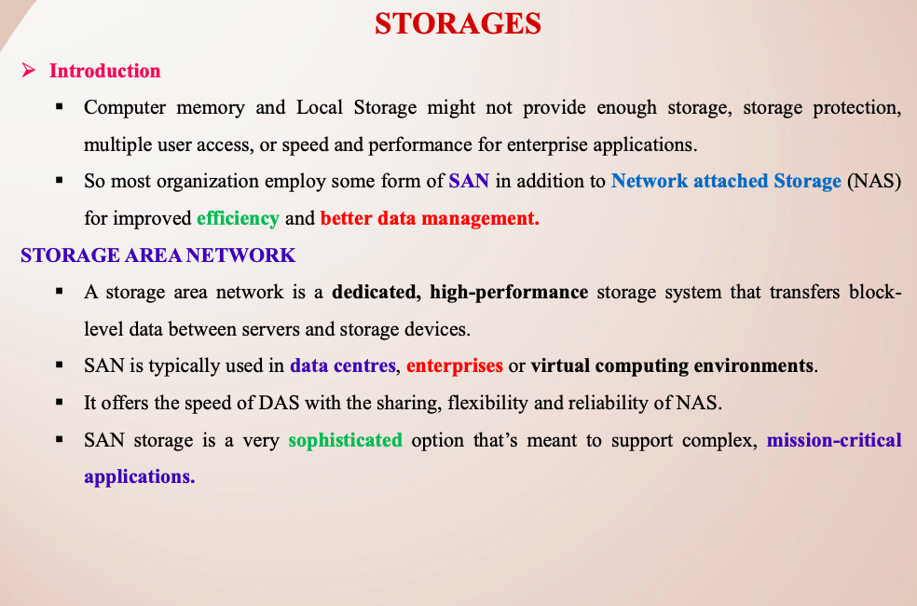

Slide 28
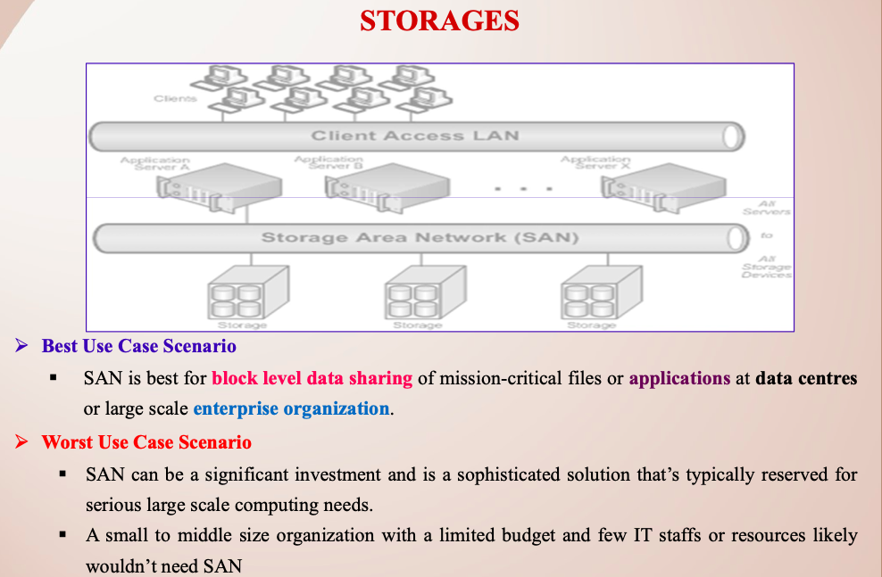

Slide 29
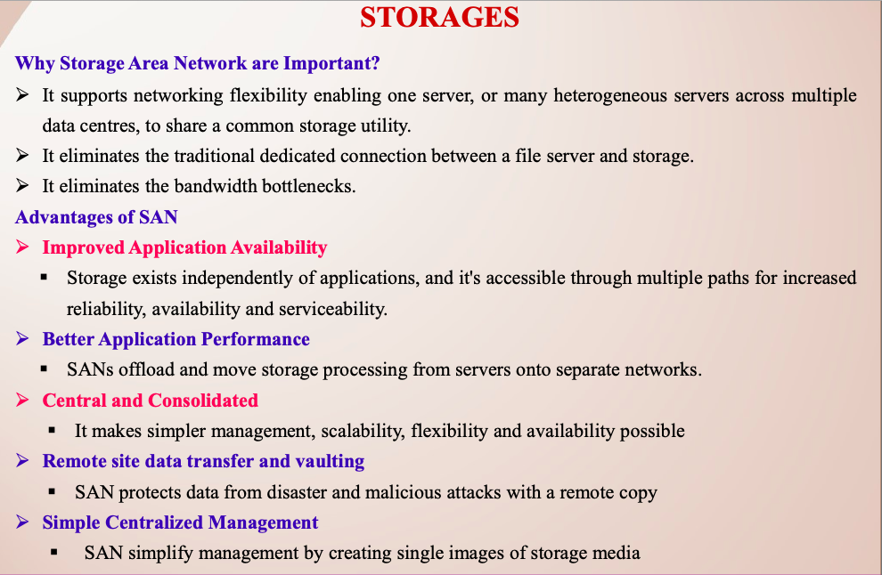

Slide 30
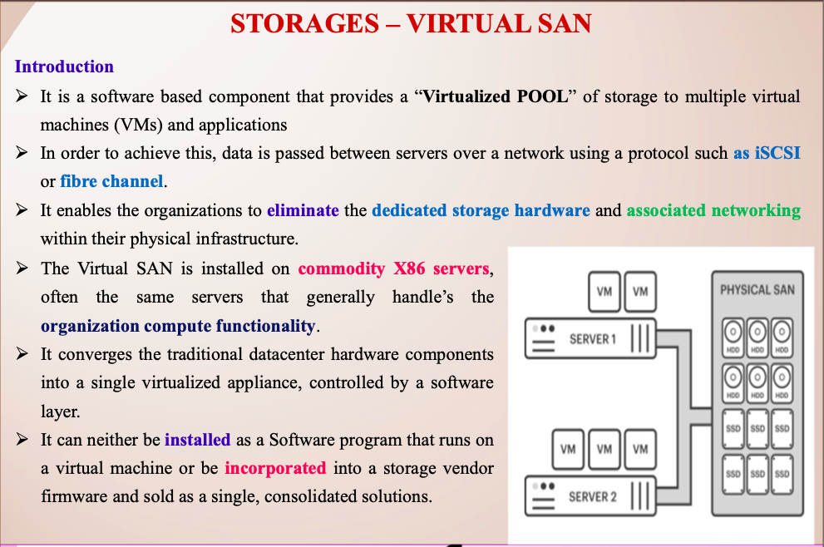

Slide 31
Preferred Text Book
➢ Cloud Computing Bible: Barrie Sosinky – 1st Edition, Wiley India Pvt. Ltd.
➢ Cloud Computing: Fundamentals, Industry Approach & Trends by Rishabh Sharma, Wiley ➢ Cloud Computing: Principles & Paradigms by Raj Kumar Buyya, James Broberg, Andrzej Goscinski, Wiley

